Slide 1

TRAFFIC MONITORING
USING RADAR
HARDWARE EDITION!!

Slide 2
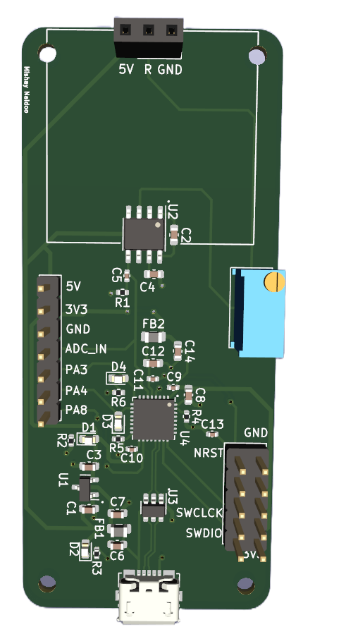
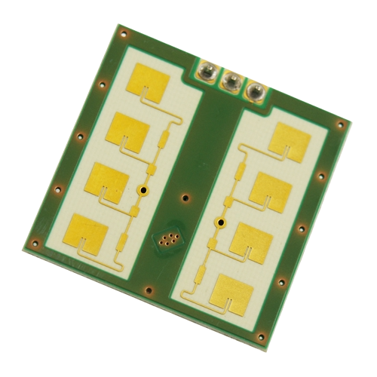
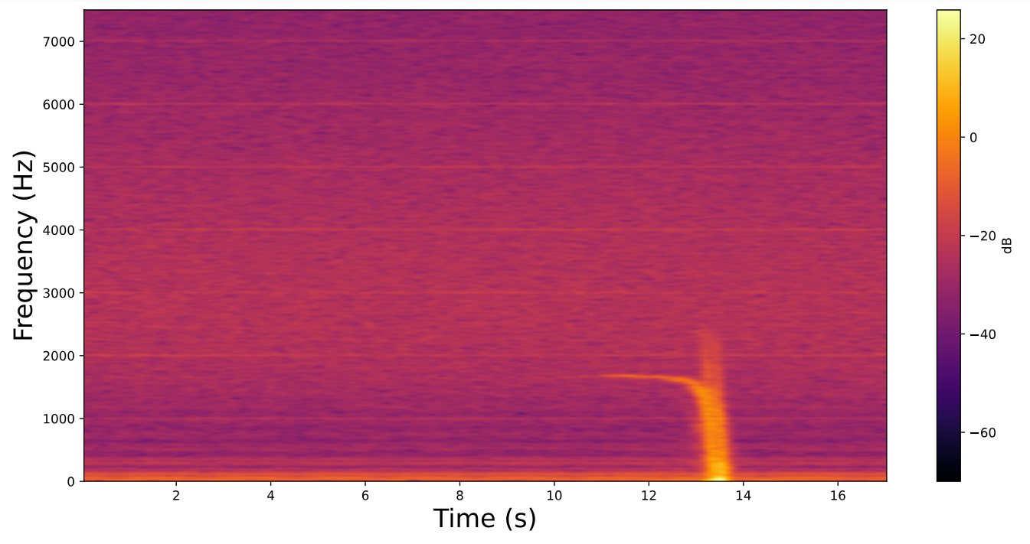
Where we left off…
Replicate/improve the data capturing setup from 4022 using cheaper components on a single PCB
Designing a system to capture traffic data using the CDM324 Doppler radar
Designed PCB V1:
4022 Setup thrown onto a PCB with an STM32L4

Slide 3
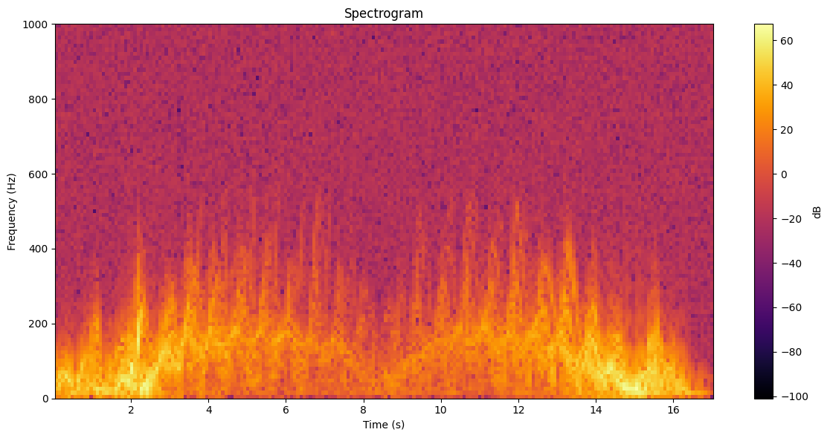

Slide 4

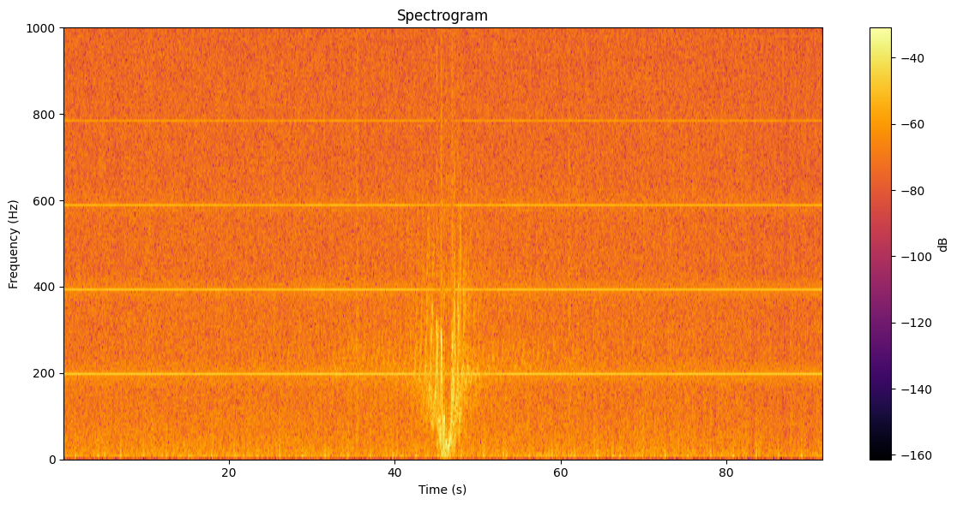

Slide 5
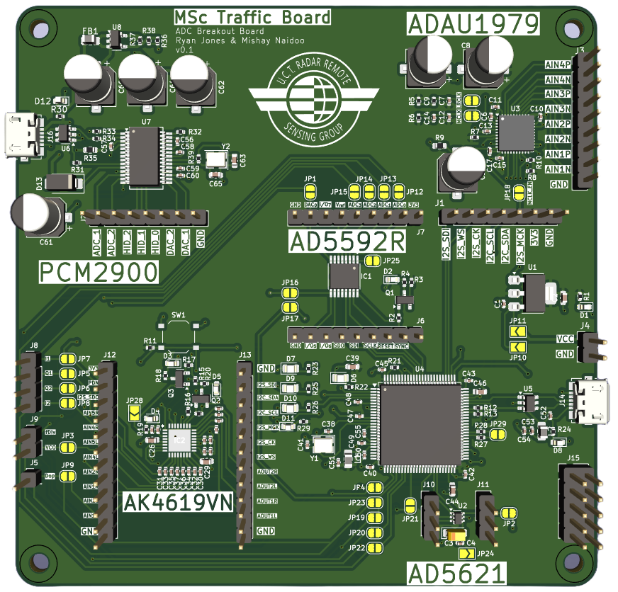
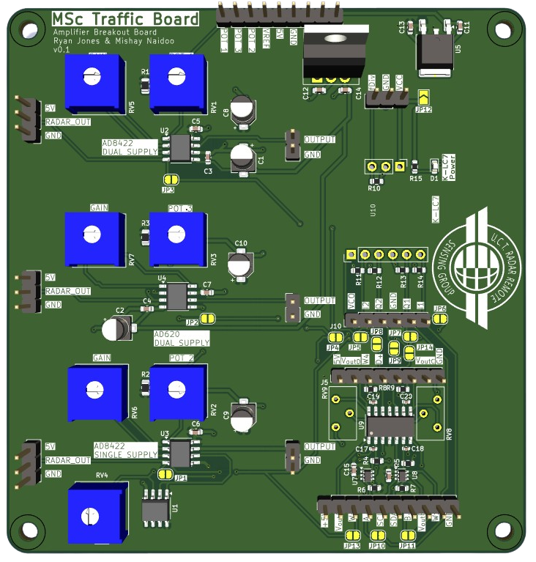
Fixing the PCB
ADC Board
Amplifier Board

Slide 6
PCM2900
16 Bit ADC
2 Inputs
2 DAC Outputs
Easy plug and play USB setup
ADAU1979
24 Bit ADC
4 Inputs
No DAC
Most complicated to setup
STM32H7
16 Bit ADC
Many Inputs
Many DAC Outputs
Easy setup

Slide 7
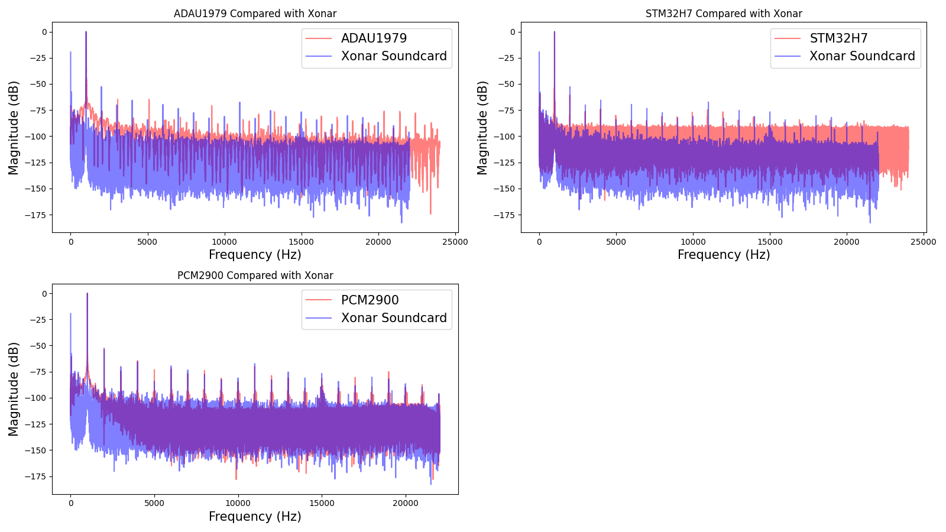

Slide 8
Fixing the PCB
Amplifier Board

Slide 9
AD8422 AND AD620
Instrumentation Amplifiers
Require +5V and -5V Dual Rail Power Supply
MCP6024
Operational Amplifier
Single 5V Supply

Slide 10
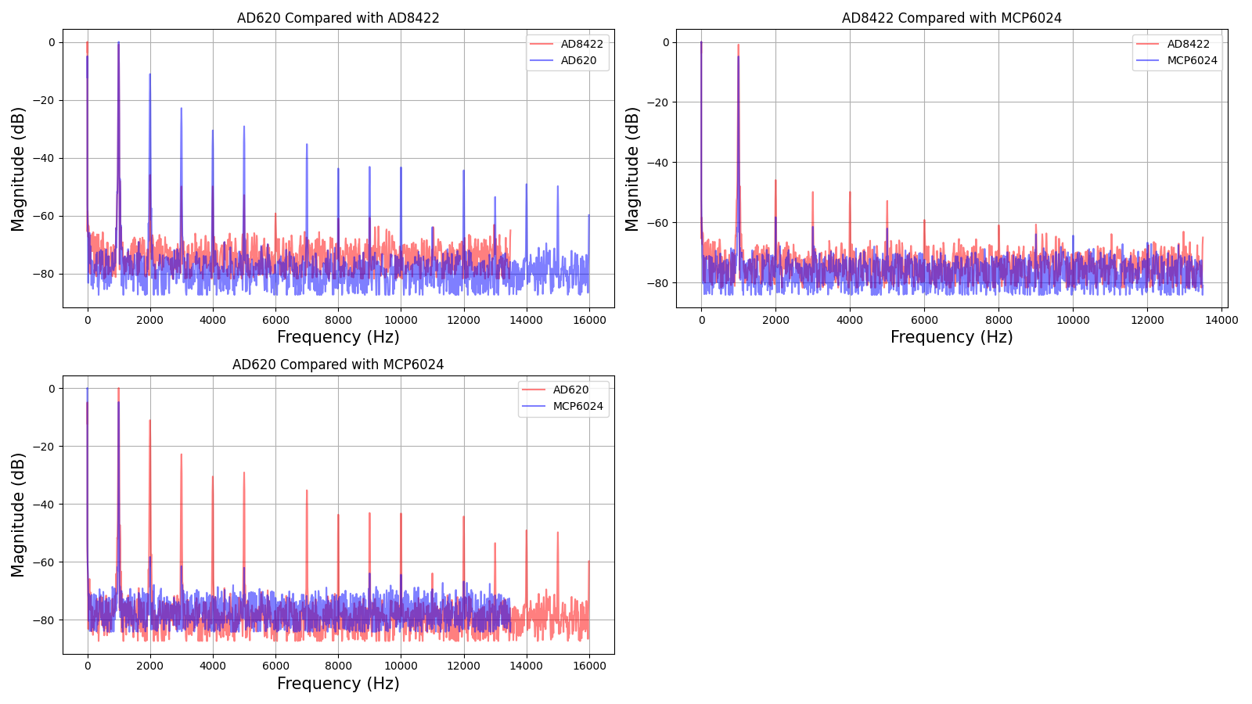

Slide 11
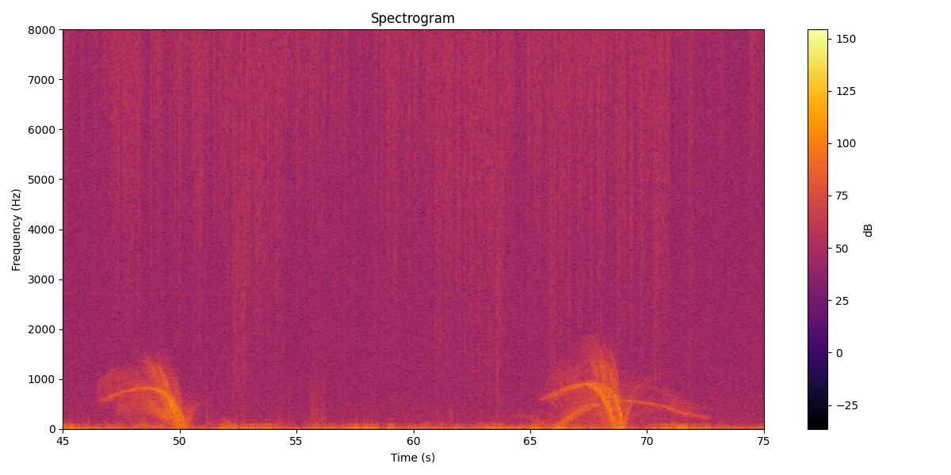

Slide 12
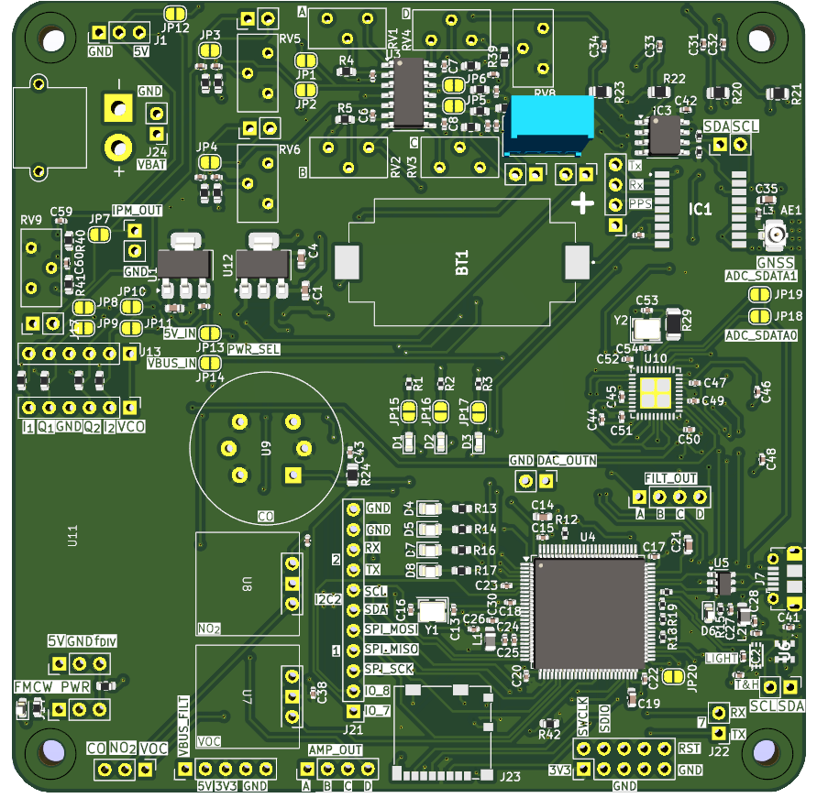
Final Board Version 1
ADAU1372 24 Bit DAC
MCP6024 Amplifier
STM32H7
SD Card

Slide 13
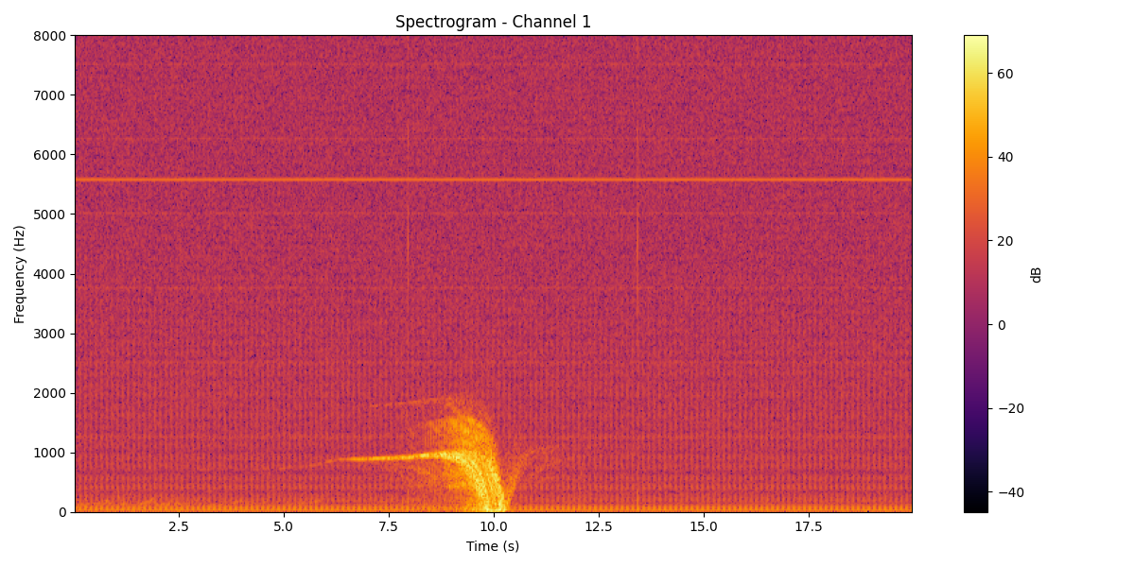

Slide 15

Next Steps
Get the DAC working and capture FMCW data
Refine the Final Board design and order V2
Capture more data with the board
Do some processing of the CW data

Slide 16

Next Seminar
HARRY NEL!

